Slide 1
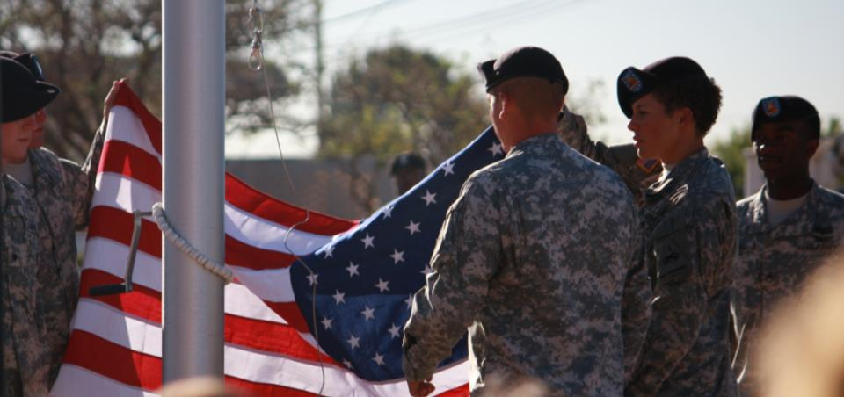
Fort Bliss Army Growth and Force Structure Realignment Draft Environmental Impact Statement
Public Meeting November 2009
Notes:
Introduction: John Barrera
Welcome to this PUBLIC Meeting for the draft Environmental Impact Statement or “eis” for the Army Growth and Force Structure realignment at Fort Bliss. Thank you for attending our meeting and we appreciate your assistance. I AM john Barrera, project manager for the EIS, and I will be introducing the participants of this Meeting.
TONIGHT YOU WILL LEARN ABOUT Actions proposed at Fort Bliss THAT have the potential to impact the natural and human environment in and around Fort Bliss . These actions include the additions of military units, new facility construction, and different MILITARY uses of the Fort Bliss Training Complex.

Slide 2
Agenda
Introduction - Mr. Barrera
Welcome - COL Wells
Purpose and Need for the Action - COL Wells
Alternatives and the EIS Findings - Mr. Maillet
30-Minute Break and Poster Session
Comments from the Audience - Mr. Perry
Notes:
WE BEGIN THE EVENING with A welcome and a brief overview of the purpose and need for the action by the fort bliss deputy garrison commander, COL wells, and an explanation of the nepa process and results of the eis by Mr. Maillet and then the eis process and schedule by the meeting facilitator, mr. perry. AFTER the presentation you are invited to VISIT THE poster Stations at the back of the room. IF YOU HAVE questions please hold them for after the presentation, and STAFF FROM the INSTALLATION AND PROJECT TEAM WILL BE ON HAND TO HELP YOU during the poster viewing portion of this meeting. After the break, mr. perry will facilitate the verbal comment portion of the meeting.
Thank you FOR YOUR COOPERATION.
IT IS Now MY PLEASURE to introduce Colonel Leonard Wells, Deputy Garrison Commander for Transformation at Fort Bliss.

Slide 3
Welcome COL Leonard E. Wells Deputy Garrison Commander for Transformation
Notes:
Welcome: COL wells
Good evening, Ladies and Gentlemen. I am Colonel Leonard Wells, Deputy Garrison Commander for transformation at Fort Bliss. On behalf of the United States Army, I thank you for being here tonight AND PARTICIPATING IN THIS IMPORTANT NATIONAL ENVIRONMENTAL POLICY ACT OR “NEPA” PROCESS.

Slide 4
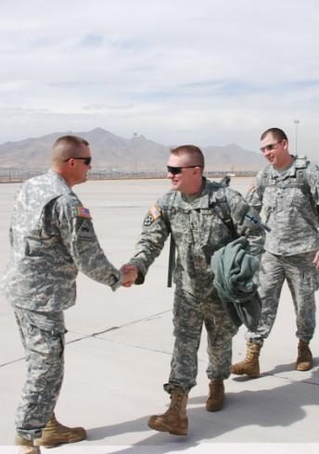
Welcome
Thank you for taking the time to participate in this important National Environmental Policy Act process.
Overview:
Explanation of NEPA
Explanation of EIS process
Purpose and Need
Proposed Alternatives
Key Findings of Draft EIS
Notes:
In response to recent congressional mandates and presidential directives generally referred to as the “Grow the army” initiatives, the Army has increased the number of troops assigned to fort bliss. we must train these troops to exacting standards to increase survivorship in warfare. To do this, Troops must take advantage of all terrain types available as part of that training. With the varied terrain available, Fort bliss is an important resource for the army. for this reason, the army has chosen to station troops at fort bliss and is generating this environmental impact statement to assess the impacts of doing so. This eis before you now is tiered to, or connected to, a programmatic EIS called the “Grow the Army or GTA EIS” completed by the army in 2007. Your input IS An important part of this overall eis process.
tHis DRAFT EIS HAS EVALUATED A RANGE OF REASONABLE ALTERNATIVES SUPPORTing new training and infrastructure which will support army growth beyond the requirements known when we evaluated changes brought about by the Base realignment and closure decisions for fort bliss In previous nepa documents.

Slide 5
Purpose of Today’s Meeting
Encourage Communication
We value your input and community involvement
Provide information
We want you to understand the GFS Draft EIS findings and learn about related growth at Fort Bliss
5
Notes:
The final eis will follow the draft eis within which the army will choose preferred alternatives. The purpose of this meeting is to give you, the public, an opportunity to provide comments on this draft eis to help us choose the best alternatives. army decision-makers will use the findings of the final eis to decide how we will support training and infrastructure needs for new troops assigned to train at fort bliss. The Draft eis explains the environmental consequences of these forthcoming army decisions and your input will assure us we have documented these consequences accurately to the greatest extent possible.

Slide 6
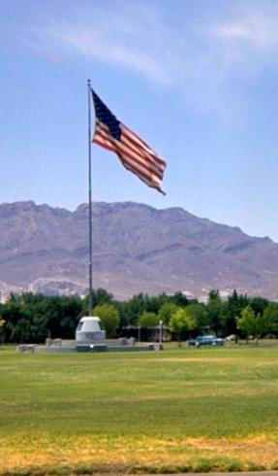
Structure of Today’s Meeting
Summary of the GFS Draft EIS
Informational poster session
Opportunity to submit oral comments
6
Notes:
I have brought with me tonight additional members of my staff AND THE PROJECT TEAM. They will present to you information about the framework within which thIS process operates, followed by a description of the specific mission alternatives, and key findings. following this presentation, there will be a poster session during which you can review information from the eis and ask our subject matter experts questions.
We are asking tonight that you – members of the community in which we live and work – provide us with your formal comments on the proposed alternatives included in the draft eis.

Slide 7
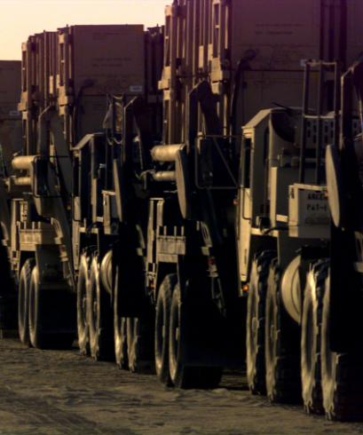
Purpose and Need
Army is in a period of transition and has taken action to realign existing forces and increase its end strength.
Proposed Action supports growth of the Army and allows for reasonably foreseeable future stationing actions at Fort Bliss.
Notes:
The Army is in a period of critical transition. Civilian leadership has mandated the army increase or grow in size. Also, Army leadership has begun the 30 year process of transforming away from a Cold War focus to meet new unconventional threats to national security. Transformation efforts continue by fielding a force best configured to meet the evolving national security and defense requirements of the 21st century.
In order to further Army growth and Transformation, meet the increased national security and defense requirements of the 21st century, maintain training and operational readiness levels, and preserve a high quality of life for U.S. Army Soldiers and Families, the Army will increase its overall size while continuing to restructure its forces in accordance with modular Transformation decisions.
The Army has taken action to realign existing forces and increase its strength to a size and configuration that is capable of meeting national security and defense objectives, sustains unit equipment and training readiness, and eases the deployment burden on its Soldiers and Families. The growth of the Army allows for the adjustment of the composition of its forces to continue to accommodate Transformation objectives and create additional unit capabilities in high demand areas where mission requirements exceed current manning authorizations. The implementation of Army growth will allow the Army to field a sustainable force matching mission requirements of the current security environment.

Slide 8
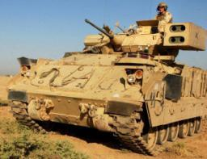
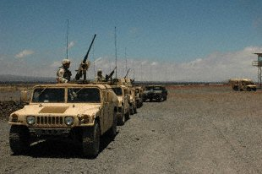
Purpose and Need for Proposed Action
Implement the Grow the Army (GTA) stationing decisions identified in the Record of Decision (ROD) for the 2007 GTA Programmatic EIS
ROD directed the stationing of two IBCTs in addition to the 4 HBCTs directed by the Base Realignment and Closure (BRAC)
Notes:
The Army’s proposed action includes Fort Bliss support for the growth of the Army and allows for reasonably foreseeable future stationing actions taking advantage of the training opportunities at this installation. this DRAFT EIS HAS EVALUATED A RANGE OF REASONABLE ALTERNATIVES SUPPORTing THE RECORD OF DECISION FOR THE 2007 GROW THE ARMY PROGRAMMATIC EIS.
that 2007 record of decision directed the stationing and training of two infantry brigade combat teams at fort bliss, also known as “Infantry BCTs.” the two infantry bcts along with the four heavy brigade combat teams, also known as “Heavy BCTs,” stationed at fort bliss per the base realignment and closure, OR “BRAC,” resulted in a total of six bctS SCHEDULED FOR stationING and training at fort bliss. THE ARMY HAS FURTHER DIRECTED THAT STRYKER BRIGADES AUGMENT OR REPLACE ONE OR MORE OF THE Heavy BCTS THAT WERE SCHEDULED FOR STATIONING AT FORT BLISS. THIS DRAFT EIS BEFORE YOU NOW ADDRESSES THE IMPACTS OF THESE INITIATIVES.
I will now introduce MR. Brian maillet, WHO WILL give an overview of this eis process and specifics of the draft eis. thank you.

Slide 9
GFS Draft EIS Summary Brian Maillet ARCADIS Project Manager
Notes:
EIS SUMMARY: Brian maillet
Thank you colonel wells. My name is Brian Maillet and I am the eis project manager for arcadis. This evening I wILL summarize the nepa process, the EIS alternatives, and consequences.

Slide 10
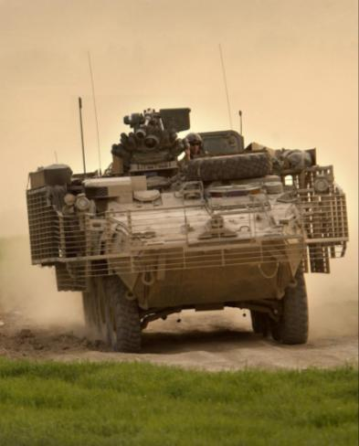
National Environmental Policy Act (NEPA)
Requires a comprehensive analysis of potential direct, indirect and cumulative effects of the proposed action and each alternative
Facilitates public and multi-agency participation in the review process
Notes:
nepa is a Federal law and is the legal framework within which this planning effort is operating. Nepa Requires a comprehensive analysis of potential direct, indirect and cumulative effects of each alternative proposed to support the training of troops at Fort Bliss.
nepa also requires public and multi-agency participation in the review process. fort bliss IS COLLECTING comments from the bureau of land management and other federal, state, and local agencies and the public using this public meeting forum, comment cards, and the availability of the draft eis document to interested parties.

Slide 11
Environmental Impact Statement (EIS) Process
Public Scoping (October 2008)
Publish Draft EIS (October 2009)
Publish Final EIS
Publish Record of Decision
Notes:
The EIS process can be broken down into four general phases: public scoping meetings; publication of a Draft EIS; publication of a Final EIS; and publication of a Record of Decision. We are currently in the draft eis phase.
in october 2008, fort bliss conducted public scoping meetings TO provide information on the proposed action and invited public comment on key issues. The public scoping meetings were conducted in the same areas AS the current public meetings: Alamogordo, which occurred last night, las cruces, el paso, and chaparral.

Slide 12
Key Issues Identified at Public Scoping Meetings
Land Use
Potential closing of Hwy 506 during military activities
Natural Resources
Grasslands and threatened and endangered species
Otero Mesa south of Hwy 506
Wildfires in Northeast McGregor Range north of Hwy 506
Cultural Resources
Archaeological surveys of controlled FTX sites
Air Space and Noise
Notes:
During the october 2008 public scoping meetings, fort bliss received comments from various agencies, organizations, and the public on the proposed action. following a review of the comments, fort bliss IDENTIFIED the following key issues THAT were of PRIMARY concern DURING SCOPING AND WERE THEREFORE ADDRESSED DURING STUDIES CONDUCTED FOR THE DRAFT eis: potential closing of highway 506 due to military training activities; potential impacts to grasslands AND threatened and endangered species; potential impacts to otero mesa; potential increase in wildfires in the northeast mcgregor range north of highway 506; potential archaeological impacts associated with increase in THE NUMBER OF controlled ftx sites and ranges; and potential impacts associated with aircraft air space and noise.
These key issues are addressed in this draft EIS and will be discussed later in this presentation. IF YOU HAVE SPECIFIC QUESTIONS ABOUT THESE ISSUES, PLEASE PARTICIPATE IN THE poster session FOLLOWING THIS PRESENTATION.

Slide 13
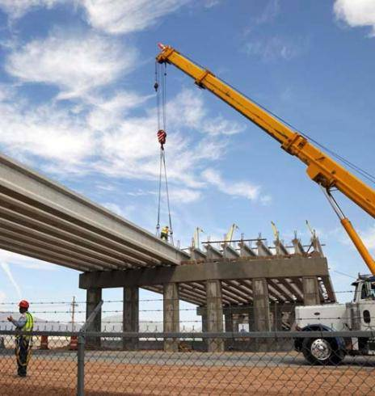
Approaches to Alternatives to Accomplish Purpose and Need
Three categories:
Stationing and Training
Land Use Changes
Training Infrastructure Improvements
Notes:
The Army has analyzed three categories of alternatives: Stationing and Training, Land use changes, and training infrastructure improvements. each category contains a No Action ALTERNATIVE and several action alternatives. the no action alternative is alternative 4 in the 2007 brac-RELATED supplEmental eis that is CURRENTLY being implemented. From each OF THESE THREE categorIES, ONE individual alternative would be selected. IN THIS SO-CALLED “CAFETERIA” APPROACH, YOU MAY THINK OF THIS AS CHOOSING THREE DIFFERENT KINDS OF FOOD FROM A MENU THAT, WHEN COMBINED, MAKE UP A COMPLETE MEAL.

Slide 14
Category 1: Stationing and Training Alternatives
ST-1
No Action – No additional units stationed, deployment of one HBCT, one HBCT TDY training
No Deployment – No additional units stationed, no deployment, one visiting HBCT training
ST-2
14
Notes:
category 1: Stationing and Training is comprised of four alternatives. The first of these is the No Action alternative. Under this option no additional units would be stationed or train at Fort Bliss, current deployment of at least one heavy bct within a three year period would continue, and one VISITING OR TDY heavy bct would complete temporary duty training at fort bliss.
Alternative 2 is the no deployment alternative. under this alternative, no additional units would be stationed at fort bliss; however, cessation of the heavy bct deployment would occur. the tdy training of one heavy bct would continue. this results in an increase of one heavy bct training on the fort bliss training complex.

Slide 15
Category 1: Stationing and Training Alternatives
ST-3
Additional Stryker – Adds one SBCT stationed at Fort Bliss, no deployment, one visiting HBCT training
Additional Units – A second SBCT, one Fires Brigade, and 3 additional SBEs stationed at Fort Bliss, no deployment, two visiting HBCT training
ST-4
15
Notes:
under Alternative 3, no deployment and the tdy training of the heavy bcts would continue. in addition, one stryker bct unit would be stationed and train at fort bliss. this results in a net increase of two bcts training on the fort bliss training complex.
The fourth alternative in this category adds reasonably foreseeable future stationing actions that may affect Fort Bliss. These stationing actions are assumed, for the sake of analysis, to include two stryker bcts with various support units. In addition, this alternative further assumes an additional heavy bct would travel to Fort Bliss for training. While Fort Bliss has not received any indication these actions would take place, in the face of increasing maneuver and training requirements we feel it appropriate to plan for the future. this alternative would result in the highest number of bcts at fort bliss, with eight units stationed and ten units training.

Slide 16
Category 1: Stationing and Training Alternatives Population Summary
ALTERNATIVES | UNITS |  |  | PERMANENT POPULATION
 | HBCT | IBCT | SBCT | Military | Other Personnel | Military Family | Total
ST-1 | 4 | 2 | 0 | 40,500 | 17,400 | 61,600 | 119,500
ST-2 | 4 | 2 | 0 | 40,500 | 17,400 | 61,600 | 119,500
ST-3 | 4 | 2 | 1 | 44,600 | 19,200 | 67,800 | 131,600
ST-4 | 4 | 2 | 2 | 51,800 | 22,300 | 78,700 | 152,800
16
Notes:
This table summarizes the number of military personnel, as well as associated family members and civilian support personnel.
Note that the total number of soldiers may be as high as 51,800.

Slide 17
Category 2: Land Use Change Alternatives
LU-1
No Action
Southeast and Northeast McGregor Range – Allows 4 km² of fixed sites in Southeast McGregor Range and fixed sites in Sacramento Mountains North of Hwy 506
Northeast McGregor Range North of Hwy 506 LU-2, plus allows Controlled FTX, Mission Support, and Live Fire; 5 km² of Controlled FTX sites; and a Controlled FTX zone in Sacramento Mountains North of Hwy 506
LU-2
LU-3
17
Notes:
The second category of alternatives covers land use changes proposed at Fort Bliss. Again, the first of these is the No Action alternative. Under this alternative no land use changes would occur in the Fort Bliss Training Complex.
The second alternative in this category would allow four square kilometers of defined bivouac and logistical support sites, known as “controlled ftx” sites, in THE Southeast McGregor RANGE and would allow the establishment of controlled ftx sites in the sacramento mountains in the northeast mcgregor range north of highway 506. The controlled ftx sites would place concentrations of vehicles and personnel in discrete areas to support training activities in the surrounding areas.
The third alternative in this category allows controlled ftx, mission support, and live fire for the entire northeast mcgregor range north of highway 506. it also adds five square kilometers of controlled sites in this area, specifically in the foothills south of the Sacramento Mountains, and establishes a controlled ftx zone in the sacramento mountains in the northeast mcgregor range north of highway 506. this alternative would support dismounted infantry Training. The broken terrain in the northeast mcgregor range north of highway 506 is valuable to support realistic infantry training, whereas the more open terrain of the Tularosa Basin is preferred for heavy bcts.

Slide 18
Category 2: Land Use Change Alternatives
LU-4
Northeast McGregor Range North of Hwy 506
LU-3, plus allows off-road vehicle maneuvers of light-wheeled vehicles within limited areas
Otero Mesa South of Hwy 506 – LU-4, plus allows 3 km³ of Controlled FTX sites adjacent to existing roads
LU-5
18
Notes:
The fourth alternative allows light-wheeled, off-road vehicle maneuver to limited areas in the northeast mcgregor range north of highway 506. More specifically, aN “hmmwv” would be permitted to off-road within 500 meters of an existing road on slopes of less than 30 percent. this would only AFFECT 27 percent of the northeast mcgregor range north of highway 506. This specifically does not allow tracked vehicles to off-road in the Northeast mcgregor range north of highway 506.
Land use alternative 5 adds three square kilometers of controlled ftx sites in the otero mesa south of Highway 506. these sites concentrate vehicles and personnel in discrete areas so as to minimize the potential damage from such concentrations in sensitive natural communities. These sites would supplement similar existing sites in this area, and be located to support dismounted infantry Training.

Slide 19
Category 3: Training Infrastructure Improvement Alternatives
TI-1
No Action
Construction of new ranges to accommodate the stationing and training alternative
TI-2 plus range camp expansions and Contingency Operation Location development
TI-3 plus rail line from Cantonment to the FBTC
TI-2
TI-3
TI-4
19
Notes:
The third category of alternatives focuses on training infrastructure improvements in the Fort Bliss Training Complex. As with previous categories, the first alternative is No Action, in which only improvements approved by the brac seis would be made to the training infrastructure at Fort Bliss.
The second alternative in this category analyzes range construction to support scheduled units’ training to standard at Fort Bliss.
The third alternative in this category adds expansion of range camps and development of contingency operating locations, known as “COL’s.” COL’s are encampments with defensive berms that more closely simulate conditions found in current military operations in afghanistan and iraq.
The fourth alternative in this category adds construction of a rail line connecting the Fort Bliss cantonment to the fort Bliss training complex. A rail line would provide a more efficient and “greener” method for units to reach the training ranges.

Slide 20
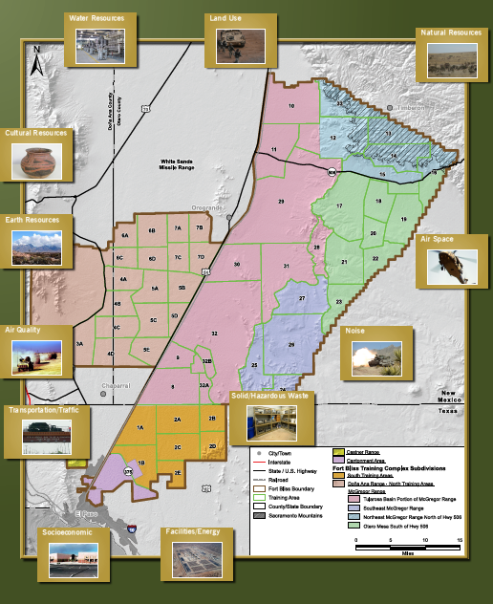
Resources Analyzed for All Alternatives
Notes:
the resources analyzed under all alternatives were land use, earth resources, natural resources, cultural resources, air quality, water resources, facilities, air space, energy demand, solid and hazardous waste, noise, and socioeconomics. the results of DETAILED STUDIES OF EACH OF THESE RESOURCES indicate that a majority of the impacts to certain resource areas would be mitigated to WHAT IS CONSIDERED less than significant under the current fort bliss land use management and planning documents. there WOULD be some UNAVOIDABLE impacts, which ARE further explained on the next slides.

Slide 21
Key Findings of GFS Draft EIS
Stationing and Training Alternatives
Air space restrictions and noise will continue
Continue coordination with airports and noise complaint hotline
Stationing and Training Alternative 4
Increased training in South Training Areas, North Training Areas, and Tularosa Basin of McGregor Range would create need to further coordinate Native American access
Land Use Alternatives
Increased military activities will reduce public access to NE McGregor
Military impacts to wildlife habitat appear low and recoverable through natural succession
Notes:
under all alternatives, including the no action alternatives, the impacts associated with air space and noise will continue. these impacts will continue to be monitored and mitigated THOUGH on-going coordination with local airports and USE OF the noise compliant hotline.
under stationing and training alternative 4, increased training on the fort bliss training complex would require CONTINUED coordination with native americans TO ENSURE access to sacred sites.
It is important to note that analyses of increased military activities in the northeast mcgregor range north of highway 506 indicate that no significant impacts would occur beyond current levels.

Slide 22
Key Findings of GFS Draft EIS
Training Infrastructure Improvement Alternatives
Current range and range camps are not adequate for ST-3 and ST-4 (would require implementation of TI-2)
Rail line would involve surface disturbance and potential for soil erosion and compaction
Through mitigation and monitoring, majority of impacts become less than significant
Communication / coordination with affected parties
Management plans
Other activities protective of the affected resource
Notes:
under stationing and training alternatives 3 and 4, training infrastructure improvements alternative 1 would not be viable BECAUSE IT IS NOT SUFFICIENT TO accommodate scheduled INCOMING UNITS OF SOLDIERS. alternative 2 at the minimum would have to be implemented, which results in additional ranges on the fort bliss training complex.
as previously stated, the results of this analysis indicate that a majority of the impacts to certain resource areas can be mitigated to less than significant under current fort bliss land use management and planning protocols and through on-going communication AND coordination between the installation and units training at the ranges.

Slide 23
GFS Draft EIS Summary Steven Perry ARCADIS Meeting Facilitator
Notes:
Rest of meeting: Steve perry
Thank you, brian. my name is steve perry, and I will summarize EIS schedule and coordinate the public comment session.

Slide 24
EIS Completion Schedule
October 30, 2009
NOA for DEIS in Federal Register
November 16-19, 2009
Public meetings
December 29, 2009
Publish Record of Decision
Publish Preliminary Final EIS
March 5, 2010
February 12, 2010
Deadline for public comments
April 13, 2010
Publish Final EIS
Notes:
the notice of AVAILABILITY OF THE DRAFT EIS WAS published in the federal register on october 30, 2009. this started the review period for the draft eis which in this case will be 60-days. this public meeting is OCCURring within that 60 day review period, WHICH ENDS DECEMBER 29, 2009. the deadline for public comments ON THE DRAFT EIS IS ALSO december 29, 2009.
The next STEP IN THE PROCESS IS publication of a preliminary final EIS, which will reflect careful consideration of comments made BY YOU AND OTHERS during the public comment period. The preliminary final EIS will be reviewed by all cooperating agencies, resulting in the publication of a final eis. the notice of availability for the final eis is currently scheduled for march 2010. the final eis will document the army’s preferred alternatives within the three categories of actions listed. following a 30 day public review period of the final eis, a record of decision on the alternatives chosen for implementation will be posted IN THE FEDERAL REGISTER.

Slide 25
Closing
Poster Session:
Project team available for specific questions
Public Comments:
Reconvene in 30 minutes to provide your verbal comments on Draft EIS
December 29, 2009 is deadline for submittal of all public comments on GFS Draft EIS document
Notes:
we will now take a 30-minute break during which you can review the posters behind you and ask questions OF the eis PROJECT TEAM, INCLUDING SEVERAL subject matter experts.
your Comments ON THE DRAFT EIS can be submitted in writing on the comment forms available at the comment station, or WHEN WE RECONVENE IN 30 MINUTES you may provide VERBAL COMMENTS that WILL BE ENTERED INTO THE RECORD BY the court recorder. All verbal comments provided to the court recorder will be included in the public record just like written comments. If you plan TO PROVIDE VERBAL COMMENTS after the break, please sign-up at the Welcome/Sign-In table SO WE CAN MAINTAIN AN ORDERLY PROCESS AND SO WE CAN MAKE TIME FOR ALL SPEAKERS TO BE HEARD AND RECORDED. We will take comments from public officials first and then by you the public in the order that you registered to comment.
IF YOU DO NOT WISH TO SPEAK OR PROVIDE A WRITTEN COMMENT TONIGHT, You are welcome to take a comment form with you that you can return by regular mail, or you can send an email to the address listed on that form.
please remember that The public comment period will CLOSE ON december 29, 2009. Please provide your comments by that DEADLINE so that they can be considered DURING preparation of the final eis. The final EIS is scheduled to be available for your review in the spring of 2010.
Thank you for joining us this evening.

Slide 26
Thank You

Slide 27
Notes:
We will now begin the oral comment portion of this meeting. Again, my name is steve perry and We will start with elected officials first (if any) who may wish to speak. then we will call members of the public in the order that you signed up to speak. Please remember to keep your comments to ____ minutes so as to give everyone a chance to speak.
Our first speaker is…
(LAST SPEAKER IS FINISHED……)
THANK YOU FOR YOUR COMMENTS. WE WILL NOW CONCLUDE THIS PORTION OF THE MEETING. THE EIS STAFF WILL BE AROUND FOR A FEW MORE MINUTES IF YOU HAVE ADDITIONAL QUESTIONS. YOU ARE WELCOME TO SUBMIT ADDITIONAL WRITTEN COMMENTS BETWEEN NOW AND DECEMBER 29TH. IF YOU WOULD LIKE TO SUBMIT WRITTEN COMMENTS TODAY, THERE ARE COMMENT FORMS AT THE WELCOMING TABLE THAT YOU CAN FILL IN AND LEAVE WITH US. FEEL FREE TO TAKE THE FORM WITH YOU IF YOU’D PREFER TO SEND YOUR COMMENTS IN LATER. AGAIN, COMMENTS POSTMARKED BY 29 DECEMBER 2009, WILL BE ADDRESSED IN THE FINAL EIS. THANKS AGAIN.
GOOD NIGHT.

